Slide 1
Capstone Project on
VietJetAir Website
Java – Selenium Batch 4
Pooja Prakash Belgaumkar
Superset ID : 5823774

Slide 2
Contents
Project Overview
Tools and Technologies Used
Project Structure
Feature Files
StepDefinitions
POM Class
Utilities
Runner Class
Extent Report
Screenshots
GitHub link

Slide 3
Project Overview
The VietJet Air Capstone Project automates end-to-end testing of the website using Selenium, Java, Cucumber BDD, and POM. It covers registration, login, flight search, booking, add-ons, and payment, with data-driven tests, cross-browser support, detailed reports, and CI/CD integration.

Slide 4
Tools and Technologies Used
Java – Programming language for writing test scripts.​​
Selenium WebDriver – For browser automation and interaction.​​
Maven – Build automation and dependency management tool.​​
TestNG – Testing framework for organizing and executing the test cases.​​
Cucumber BDD – Behavior Driven Development tool for writing tests in Gherkin syntax.​​

Slide 5
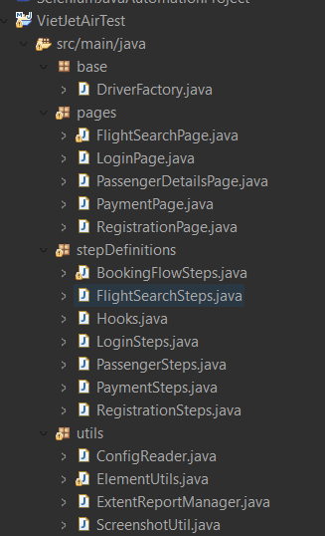
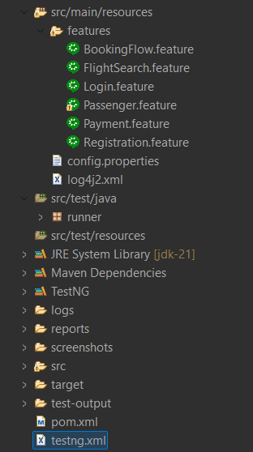
Project Structure

Slide 6
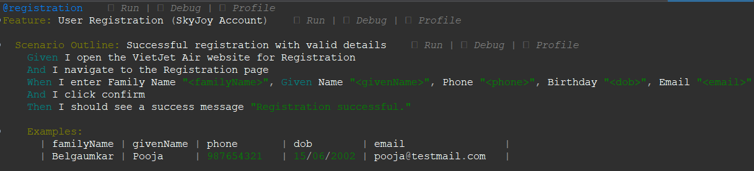
Feature Files
Feature files define the behavior of the application in plain English using Gherkin syntax. They describe what to test without worrying about the underlying code.

Slide 7
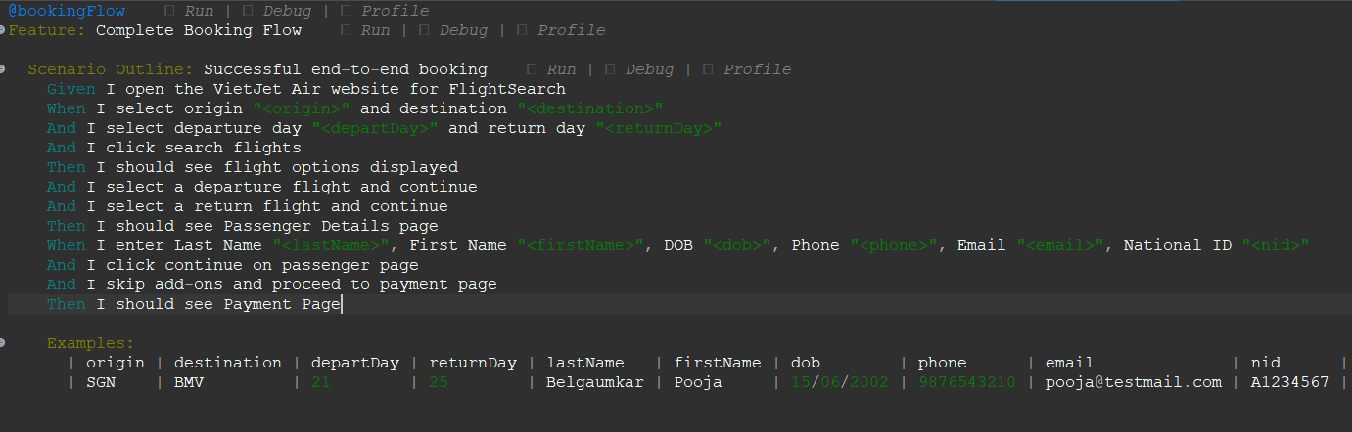
Feature Files

Slide 8
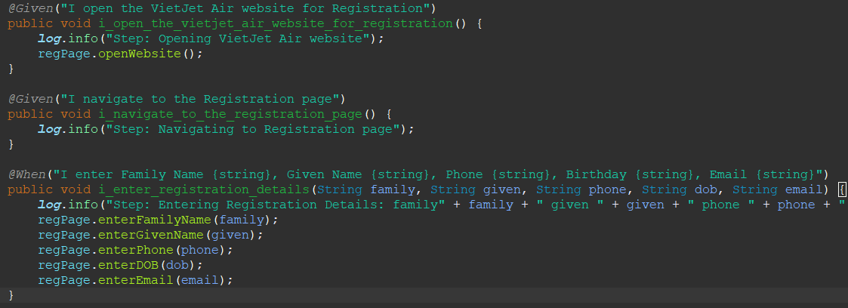
StepDefinitions
Step Definitions act as a bridge between Feature files and Selenium code. Each @Given, @When, and @Then maps a Gherkin step to actual Java methods that perform browser actions.

Slide 9
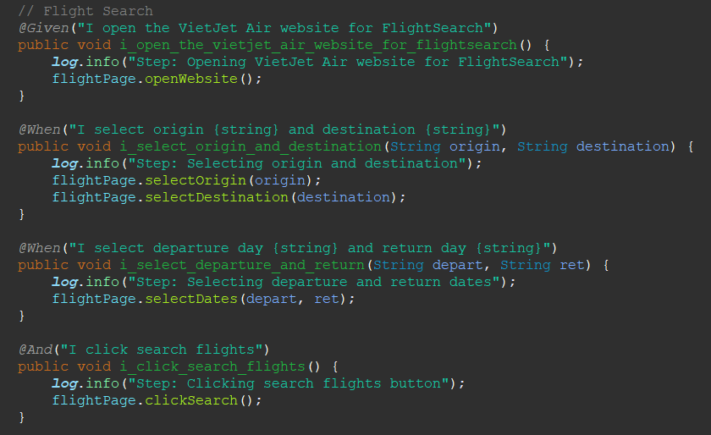
StepDefinitions

Slide 10
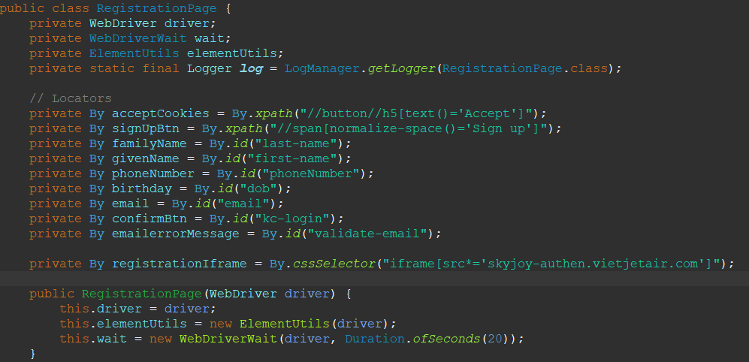
POM Class
The POM class stores locators and methods for the Registration page. It makes code reusable, readable, and separates UI details from test logic.

Slide 11
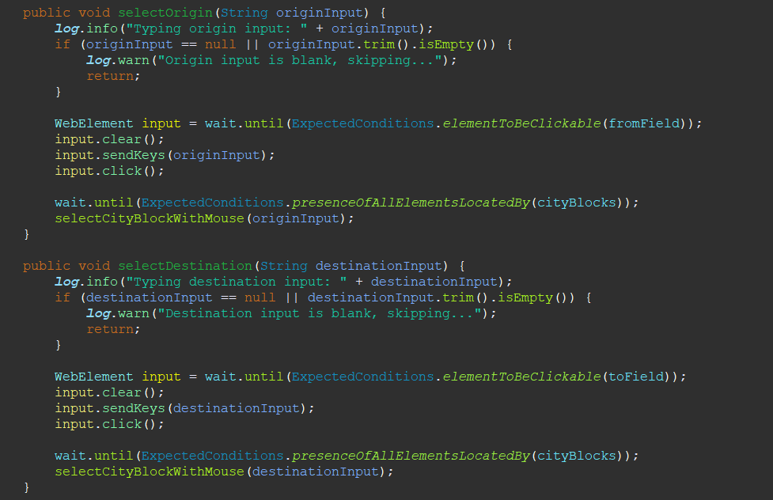
POM Class

Slide 12
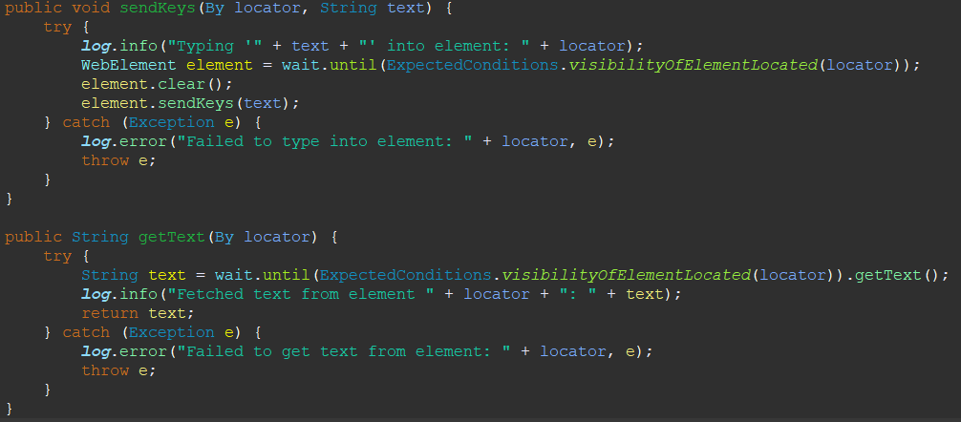
Utilities
ElementUtils:
ElementUtils provides common reusable methods like typing and fetching text. It improves code readability and reduces duplication across POM classes.

Slide 13
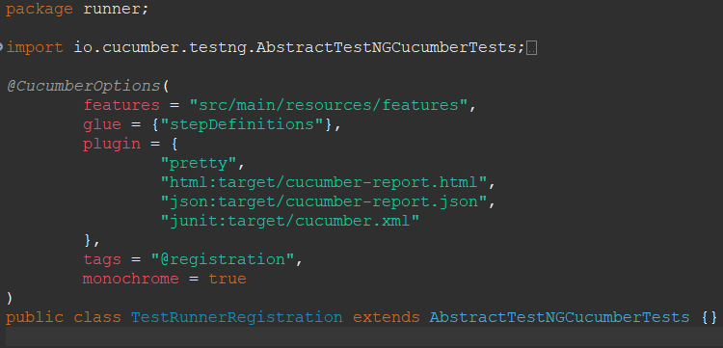
Runner Class
The Runner class executes Cucumber feature files with TestNG. It links the Gherkin steps in feature files to the Java step definitions and generates test reports.

Slide 14
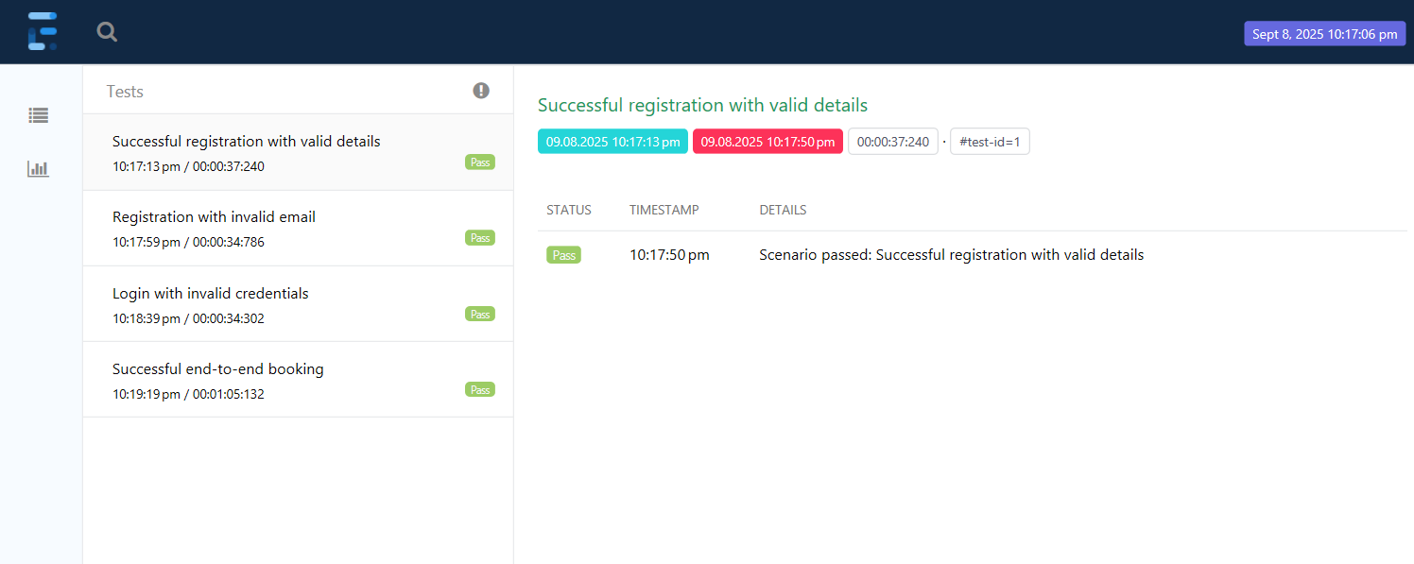
Extent Report

Slide 15
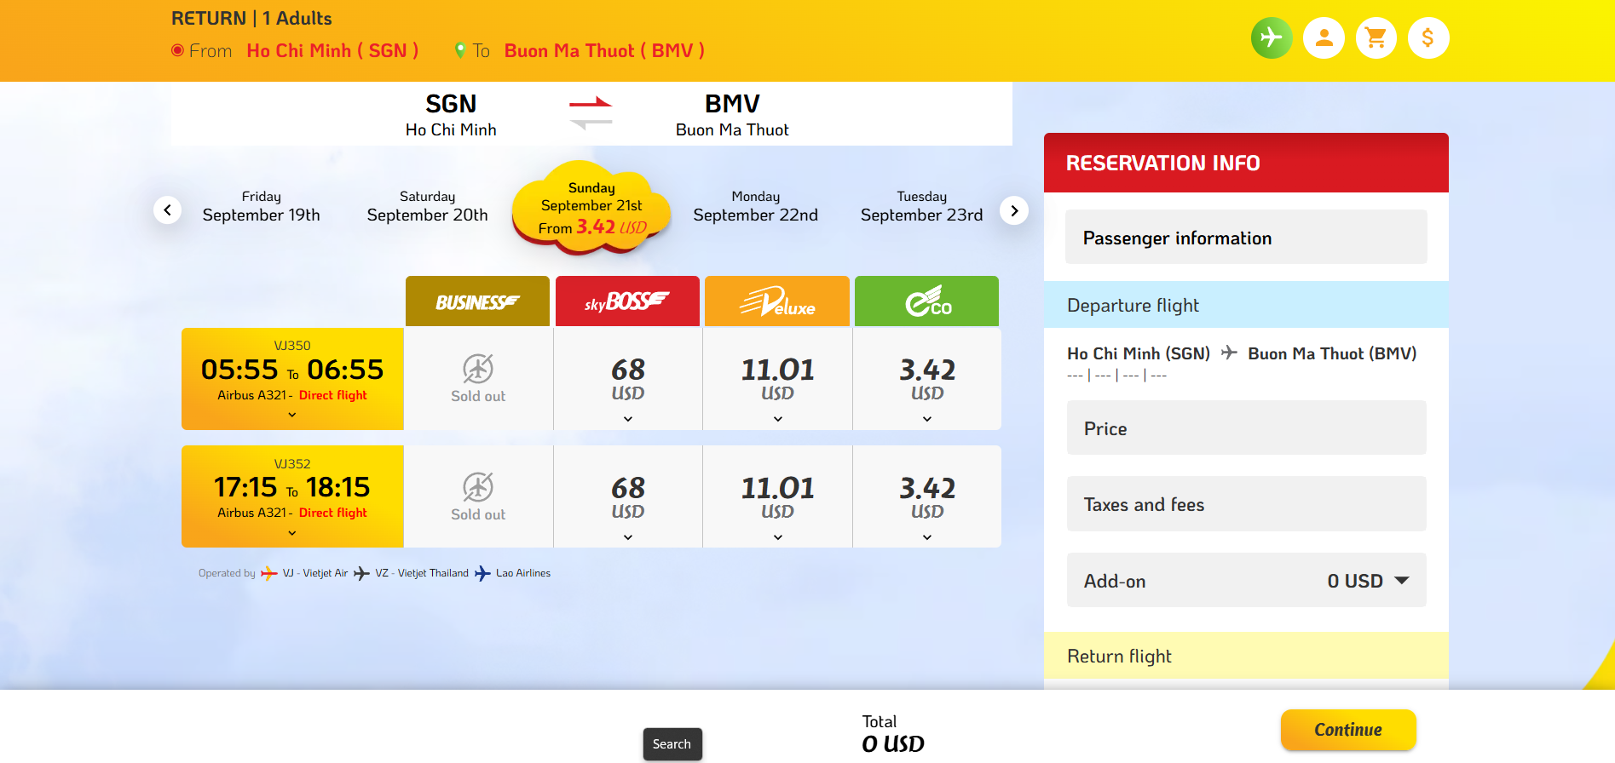
Screenshots

Slide 16
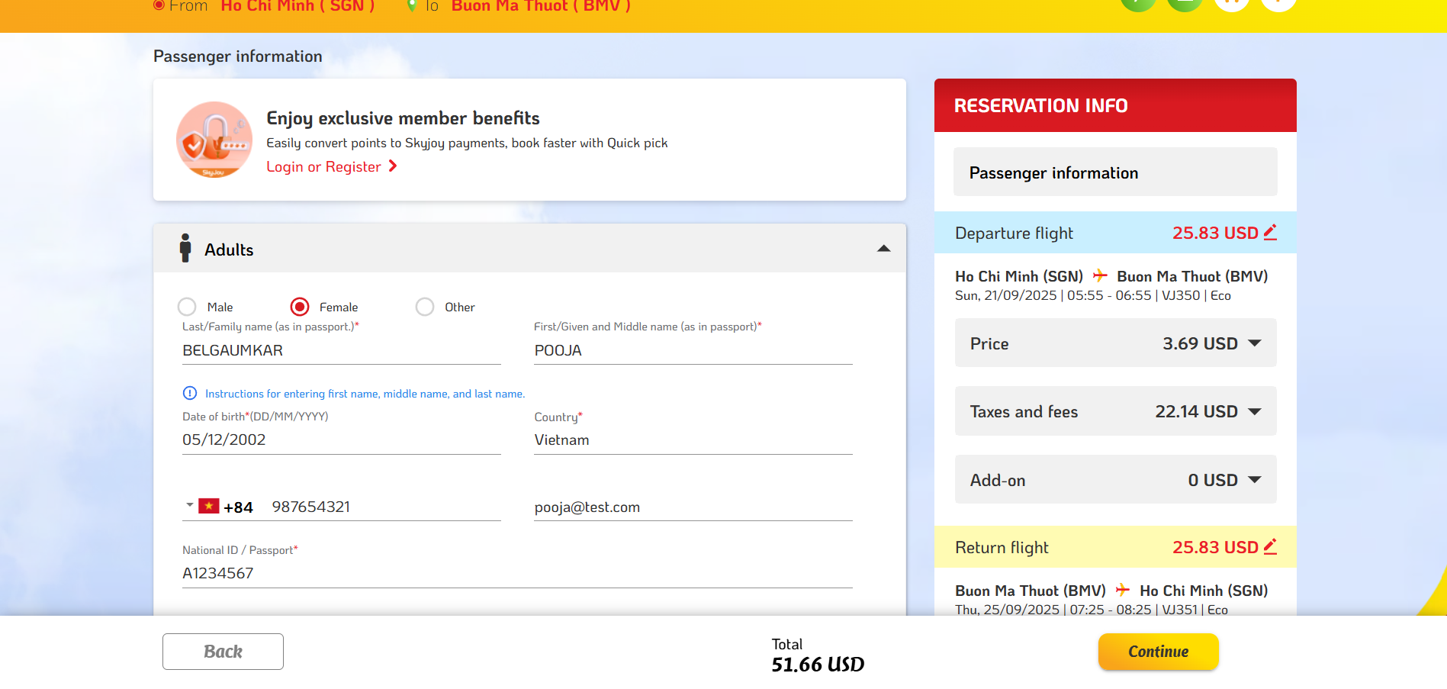
Screenshots

Slide 17
Github Link
Github Link:
https://github.com/PoojaPrakash08/WiproCapstoneProject.git

